Slide 1


Top Songs from 2010-2019
Hemin Patel
Data 101

Slide 2
Dataset
Kaggle Dataset Link
Clean dataset with 13 rows and 100 columns
Description: The top songs by year in the world by Spotify. This dataset is based on Billboard’s data and has several variables about the songs.
Attributes:
Title
Artist
Top Genre
Year
BPM
Energy
Danceability
Loudness (dB)
Valence
Duration (sec)
Acousticness
Speechiness
Popularity
Data 101

Slide 3
Attributes
BPM – Beats Per Minute - The tempo of the song.
Energy - The energy of a song; the higher the value, the more energetic.
Danceability – Describes how suitable a track is for dancing; the higher the value, the easier it is to dance.
Loudness (dB) – The loudness level in decibels, higher the value, the louder the song
Valence - A measure of musical positiveness of the track. The tracks with the highest number give a sense of positive moods.
Duration (sec) - The duration of the song in seconds.
Acousticness - A measure of how acoustic the track is.
Speechiness - The higher the value that tells how many spoken words were in the track.
Popularity - The higher the value, the more popular the song is.
Data 101

Slide 4
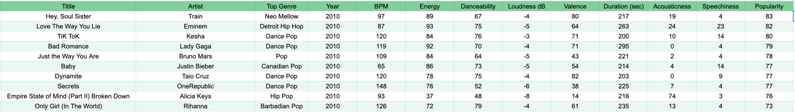
The Data
Years range from 2010-2019
For each song, the dataset shows the year it was released and lists all the attributes, such as genre, artist, etc.
Data 101

Slide 5
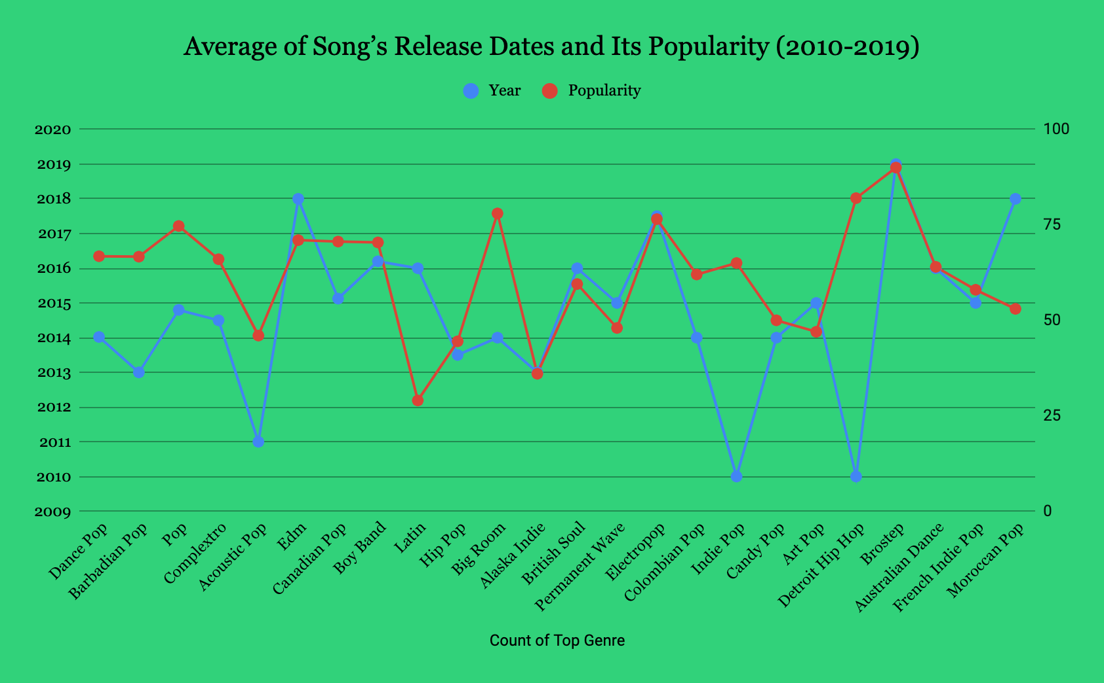
How can we use this data?
The most popular genre is Brostep*
We can see which genre was the most popular during each year.
We can use this data to predict future songs to hit the Billboards.
*Only one datapoint, check next slide
Data 101

Slide 6
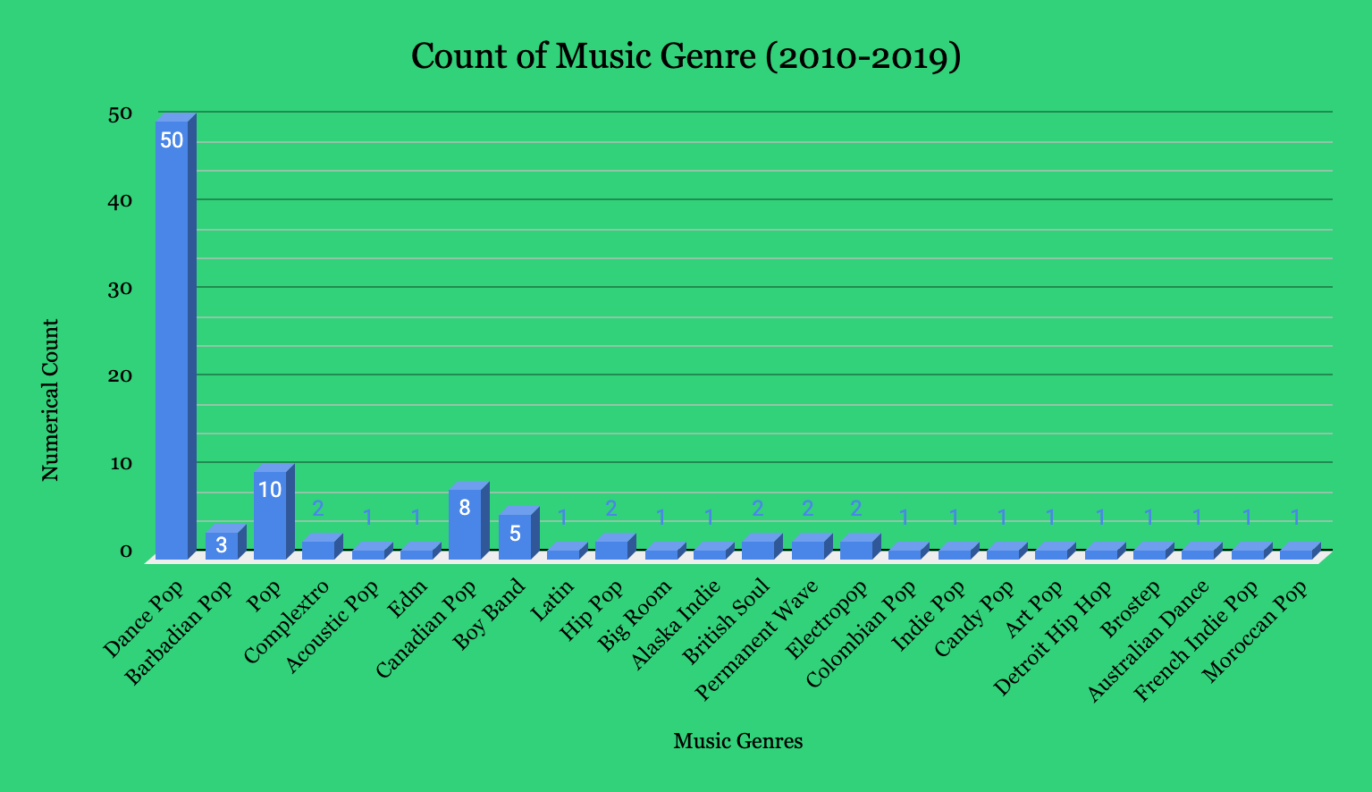
Popular Genres
Out of 100 songs, Dance-pop is the most popular and attains 50% of the data.
Many of the songs in the genres are limited, which can affect the popularity count..
Data 101

Slide 7
Why is this interesting?
This data can be used to explore trends in popularity of music genres.
How do the attributes help boost popularity?
How can we use this data to predict future hits, or to create new songs?
Can use the attributes, like BPM, and incorporate in new songs.
Data 101

Slide 8


